Slide 1
INDEXING
INDEX - Mechanism for increasing the speed of data search and data retrieval on relations with a large number of records
Most relational DBMS software tools enable definition of indexes

Slide 2
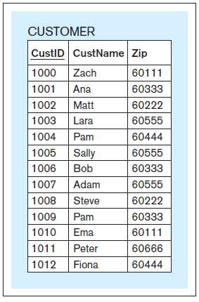
Conceptual simplified illustration of the principles on which an index is based Example relation
Notes:
This example is discussed on Pages 187-190

Slide 3
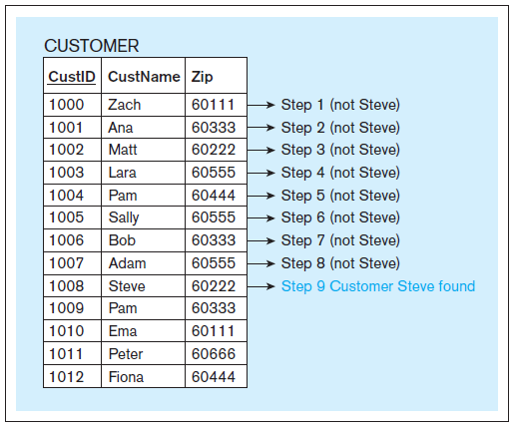
Conceptual simplified illustration of the principles on which an index is based Linear search - example
Notes:
This example is discussed on Pages 187-190

Slide 4
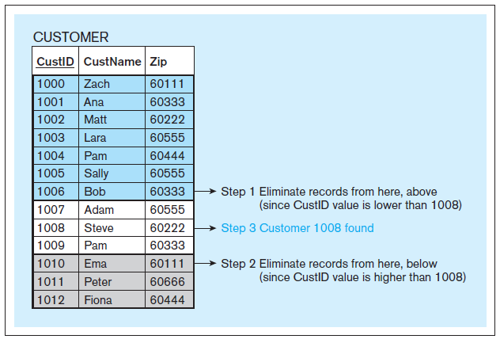
Conceptual simplified illustration of the principles on which an index is based Binary search - example
Notes:
This example is discussed on Pages 187-190

Slide 5
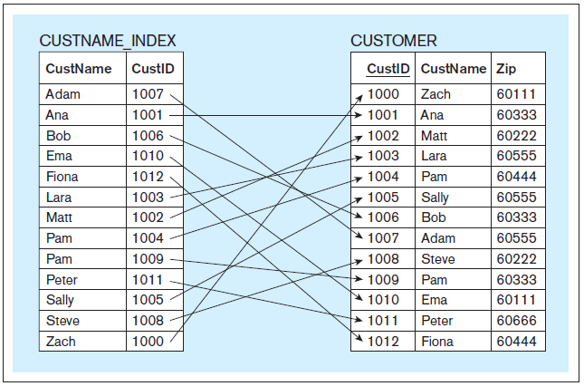
Conceptual simplified illustration of the principles on which an index is based Index - example
Notes:
This example is discussed on Pages 187-190

Slide 6
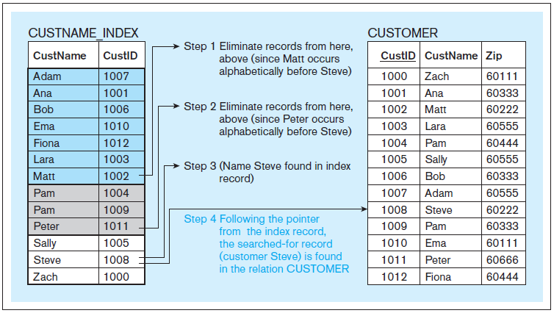
Conceptual simplified illustration of the principles on which an index is based Increased search speed using the index - example
Notes:
This example is discussed on Pages 187-190

Slide 7
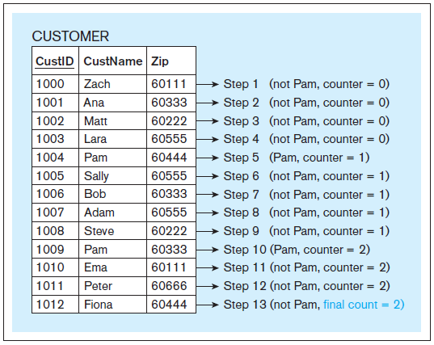
Conceptual simplified illustration of the principles on which an index is based Linear search – another example
Notes:
This example is discussed on Pages 191-192

Slide 8
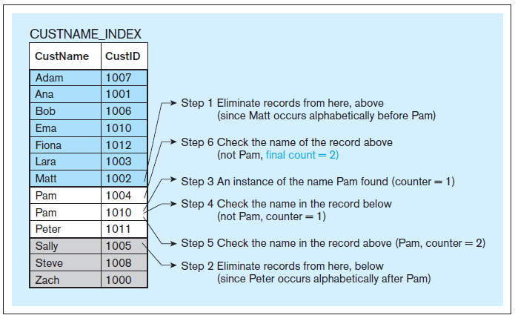
Conceptual simplified illustration of the principles on which an index is based Increased search speed using the index – another example
Notes:
This example is discussed on Pages 187-190

Slide 9
INDEXING
The preceding examples provided simplified conceptual illustration of the principles on which an index is based
Instead of simply sorting on the indexed column and applying binary search, different contemporary DBMS tools implement indexes using different logical and technical approaches, such as:
Clustering indexes
Hash indexes
B+ trees
etc.
Each of the available approaches has the same goal – increase the speed of search and retrieval on the columns that are being indexed
Notes:
In the preceding examples, for the simplicity of illustration, we used the primary key value of the record as the index pointer. In practice the value of the index pointer can be a physical address of the record on the disk or some other mechanism that relates to the physical location of records
No matter what logical and technical approaches are used by the DBMS to implement the index, the main point is: when an index is created it improves the performance of data search and retrieval.

Slide 10
INDEXING
CREATE INDEX
Example: CREATE INDEX custname_index ON customer(custname);
Once this statement is executed, the effect is that the searches and retrievals involving the CustName column in the relation CUSTOMER are faster
DROP INDEX
Example: DROP INDEX custname_index ON customer(custname);
This statement drops the index, and the index is no longer used

Slide 11
From CS525

Slide 12
Indexes
Indexes are used to speed up the retrieval of records in respond to certain search condition
Efficient access to records based on the indexing fields:
Single level indexing
Primary, Secondary and Cluster indexes
Multilevel indexing
Levels of index (index of an index)
B+Tree (dynamic)
Copyright © 2011 Pearson Education, Inc. Publishing as Pearson Addison-Wesley

Slide 13
Indexes as Access Paths
A single-level index is an auxiliary file that makes it more efficient to search for a record in the data file.
The index is usually specified on one field of the file (although it could be specified on several fields)
One form of an index is a file of entries:
<field value, pointer to record>
which is ordered by field value
The index is called an access path on the field.
Copyright © 2011 Pearson Education, Inc. Publishing as Pearson Addison-Wesley

Slide 14
Indexes as Access Paths: (cont.)
The index file usually occupies considerably less disk
A binary search on the index yields a pointer to the file record
Indexes can also be characterized as dense or sparse
A dense index has an index entry for every search key value (and hence every record) in the data file.
A sparse index, on the other hand, has index entries for only some of the search values
or nondense
Copyright © 2011 Pearson Education, Inc. Publishing as Pearson Addison-Wesley

Slide 15
Types of Single-Level Indexes
Primary Index
An ordered file whose records are of fixed length with 2 fields (Key, Pointer)
One Entry per Block
Secondary Index
A second index for an already existing primary index
May use one of the candidate key as the index key
Copyright © 2011 Pearson Education, Inc. Publishing as Pearson Addison-Wesley

Slide 16
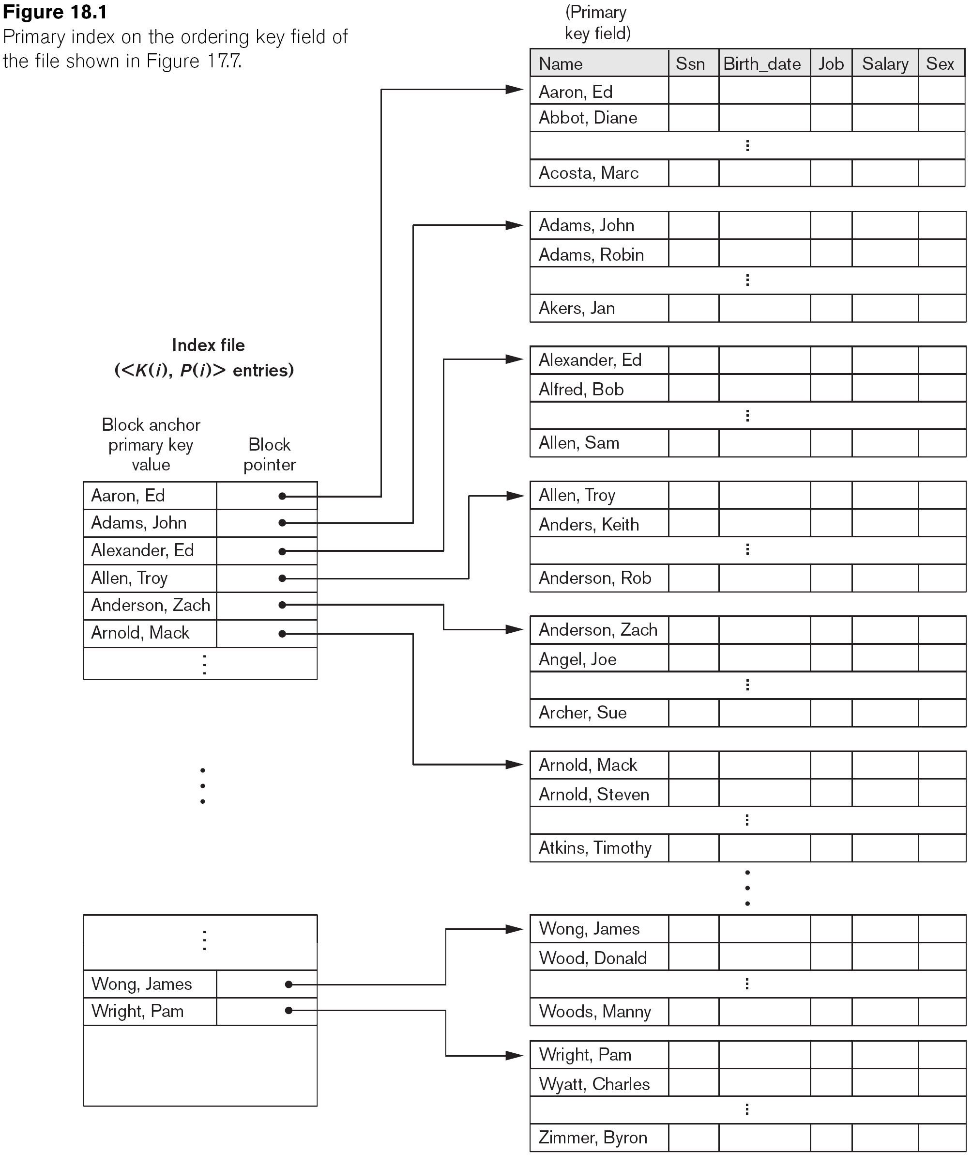
Primary Index on the Ordering Key Field
Copyright © 2011 Pearson Education, Inc. Publishing as Pearson Addison-Wesley

Slide 17
Multi-Level Indexes
Because a single-level index is an ordered file, we can create a primary index to the index itself;
In this case, the original index file is called the first-level index and the index to the index is called the second-level index.
We can repeat the process, creating a third, fourth, ..., top level until all entries of the top level fit in one disk block
A multi-level index can be created for any type of first-level index (primary, secondary) as long as the first-level index consists of more than one disk block

Slide 18
A Two-Level Primary Index

Slide 19
Multi-Level Indexes
Such a multi-level index is a form of search tree
However, insertion and deletion of new index entries is a severe problem because every level of the index is an ordered file.
Reduce the part of the index that we continue to search by bfr (block factor) also called fan-out
Searching a multilevel index divide the records into n-way (n=fan-out) at each search step
Notice in binary search fan out always=2
log₂Bi (blocks) in single level

Slide 20
Sequential File
10
20
30
40
50
60
70
80
90
100

Slide 21
Dense Index
Sequential File
10
10
20
20
30
30
40
40
50
60
50
70
60
80
70
90
80
100
90
110
100
120

Slide 22
Sparse Index
Sequential File
10
10
30
20
50
30
70
40
90
110
50
130
60
150
70
170
80
190
90
210
100
230

